Slide 1

Pharmacy Database
Code First Girls - SQL Project

Slide 2
Purpose
Aims to streamline the management of a pharmacy's operations by organising and maintaining crucial information related to drugs, suppliers, customers, sales, and inventory.
The database is designed to facilitate efficient tracking of pharmaceutical products, supplier relationships, customer interactions, and overall inventory management.

Slide 3
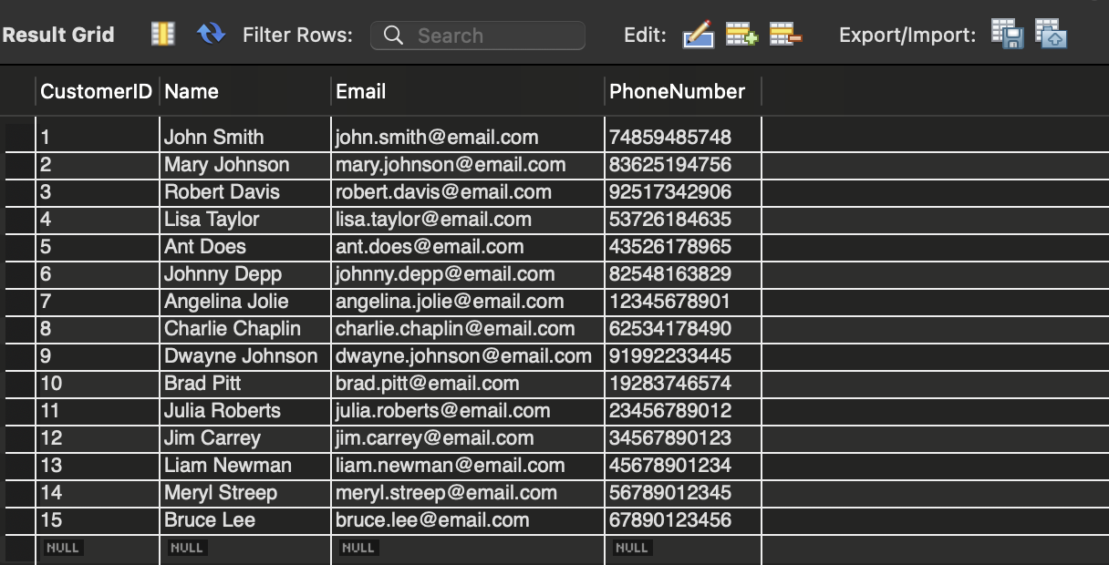
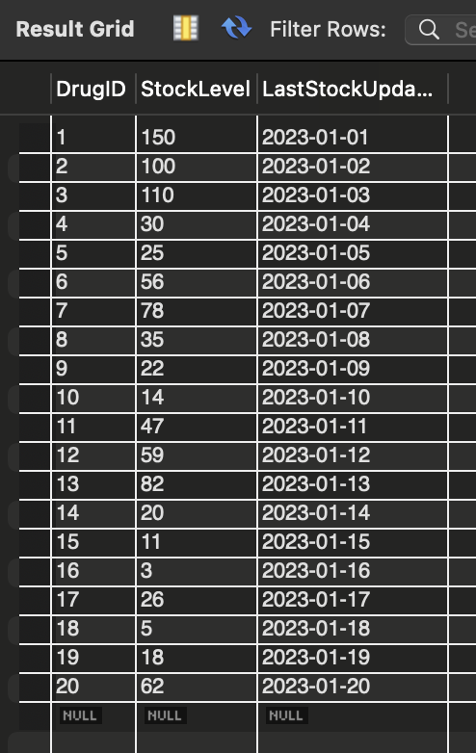
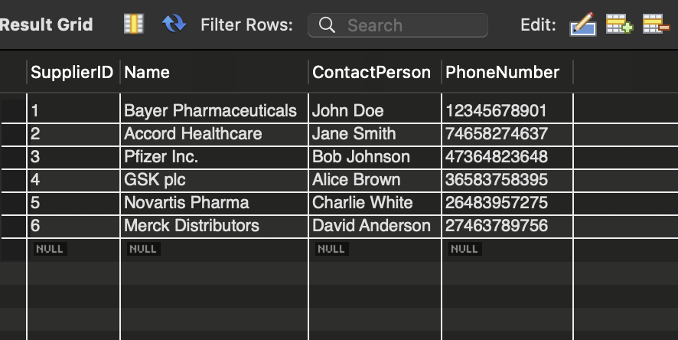
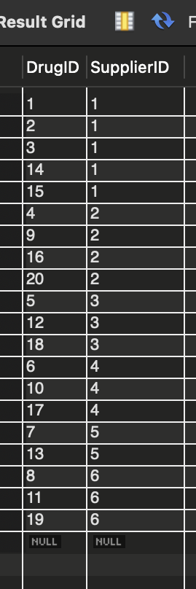
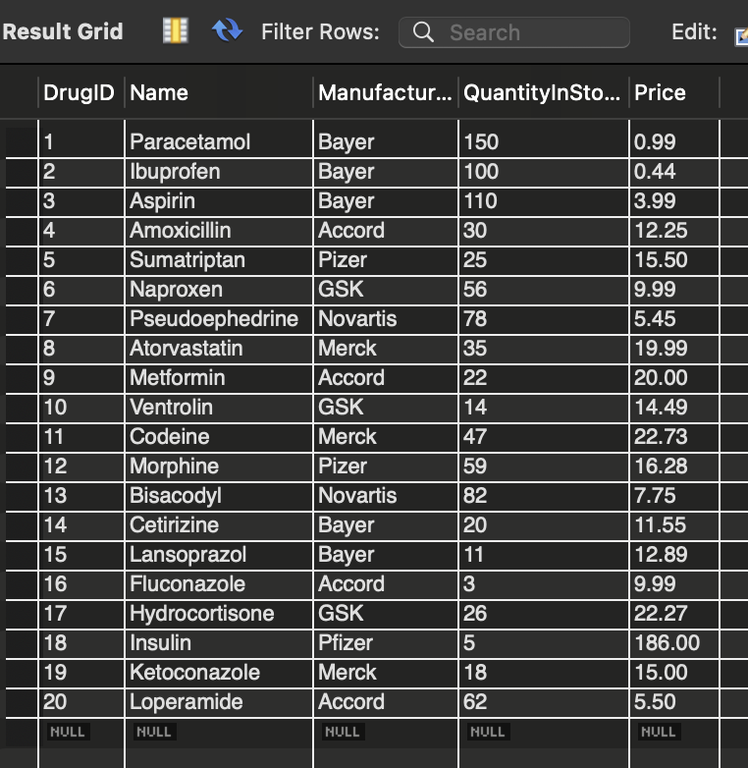
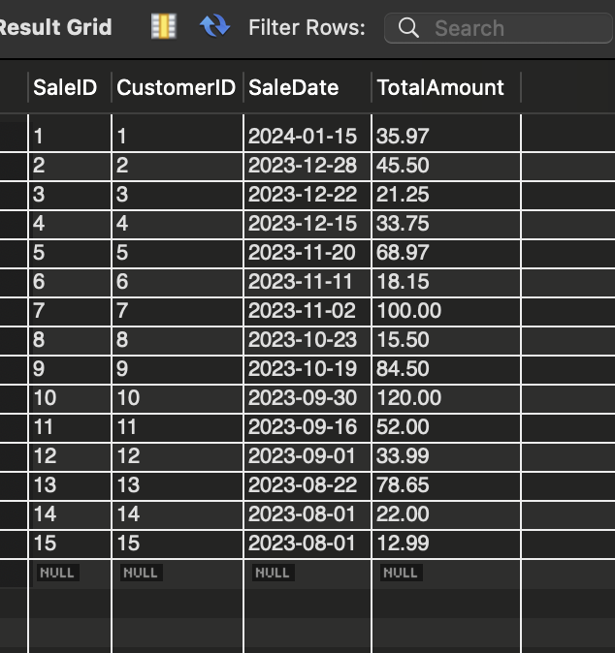
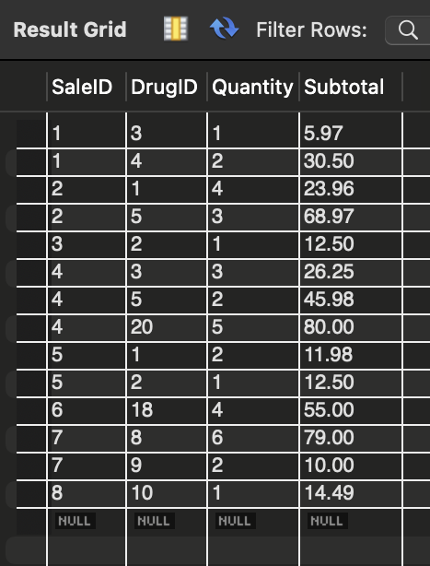

Slide 4
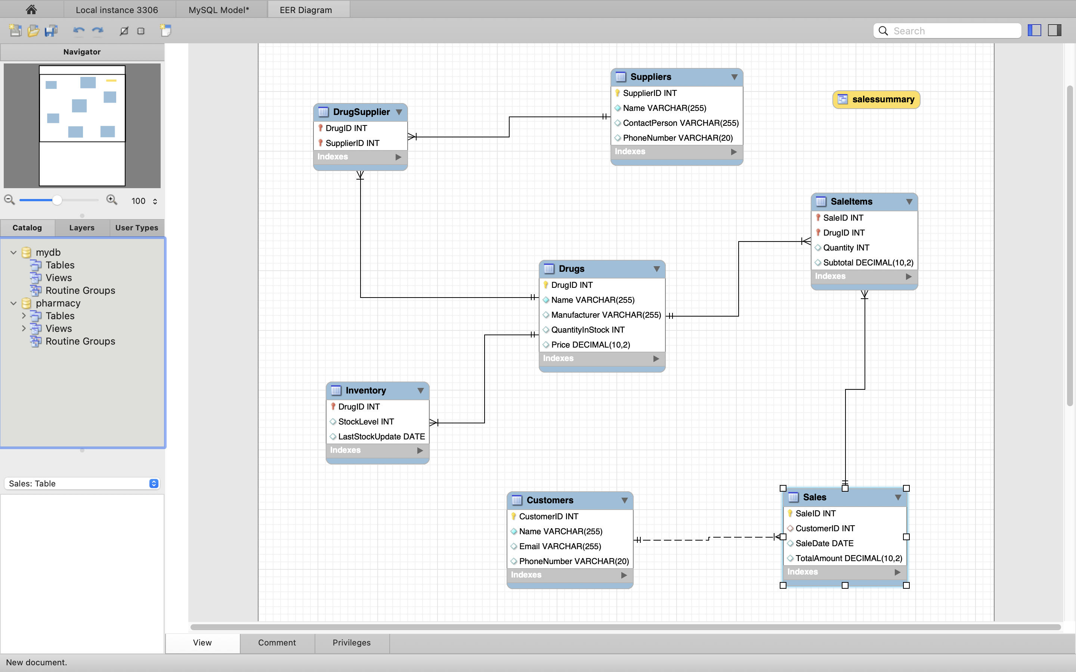
EER Diagram

Slide 5
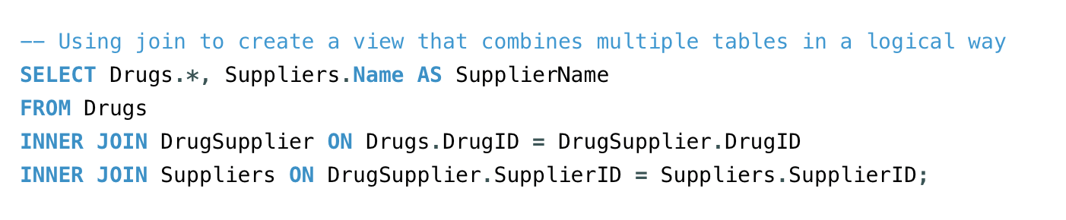
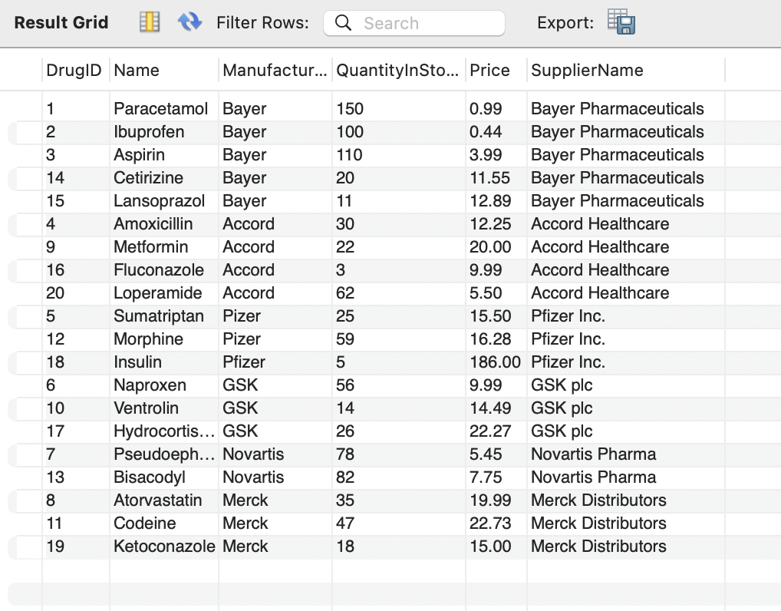
Joins
Used inner join to retrieve information about drugs along with details about their suppliers

Slide 6
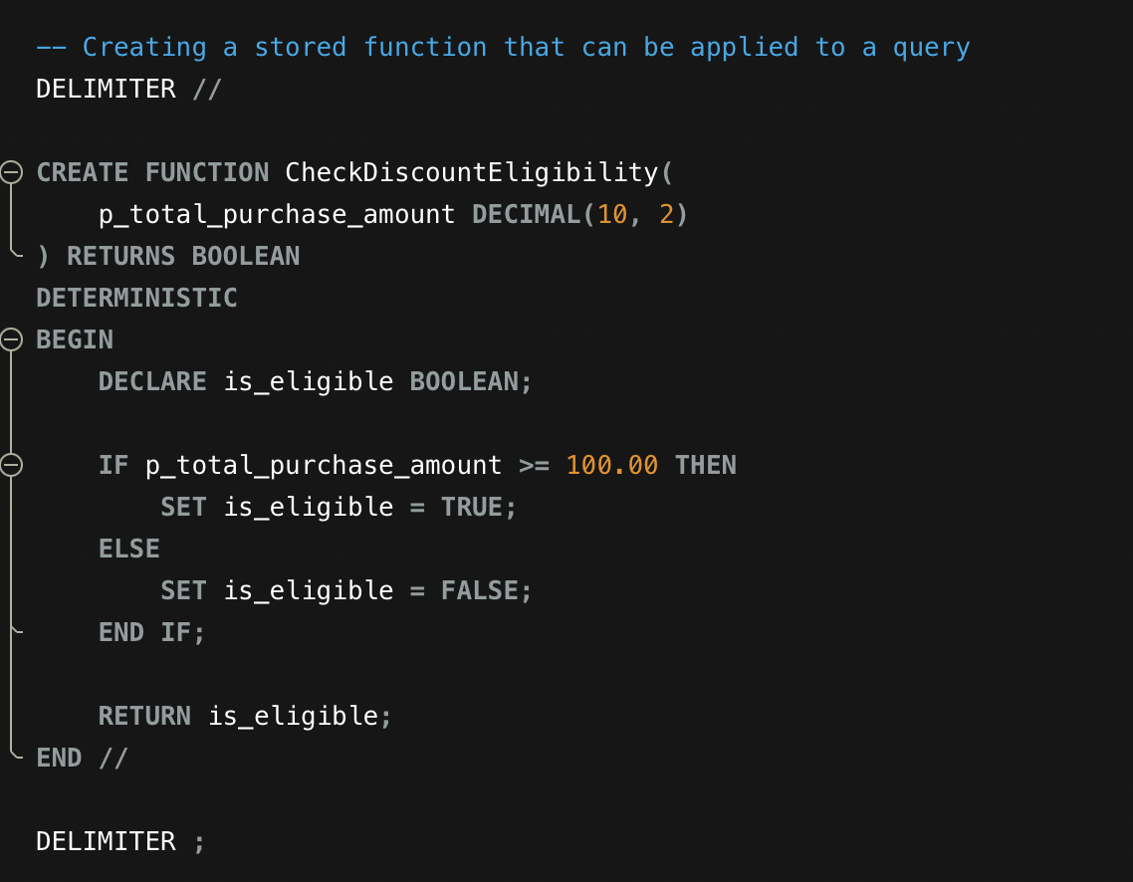
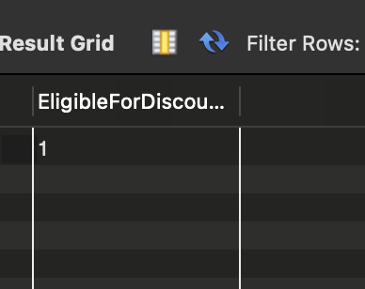
Stored Function
takes one input parameter total purchase amount and returns a boolean value indicating whether the customer is eligible for a discount based on their total purchase amount.

Slide 7
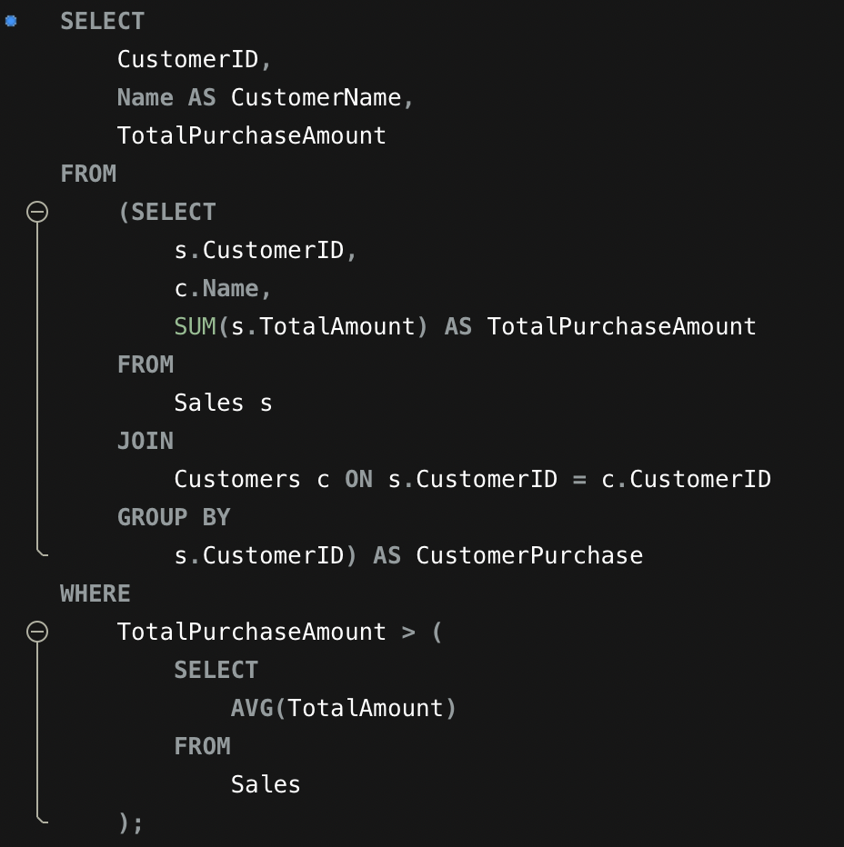
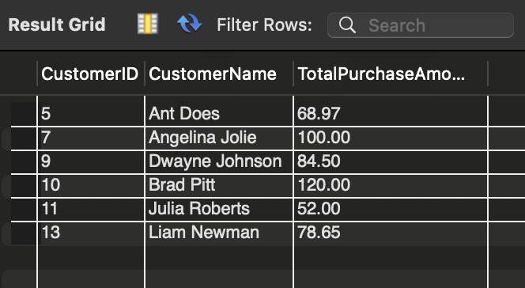
Example query with a subquery to demonstrate how to extract data
Retrieve information about customers who have made purchases exceeding the average total purchase amount.
This query can be used to identify customers who are spending more than the average, allowing for targeted marketing efforts or further analysis of high-value customers.

Slide 8
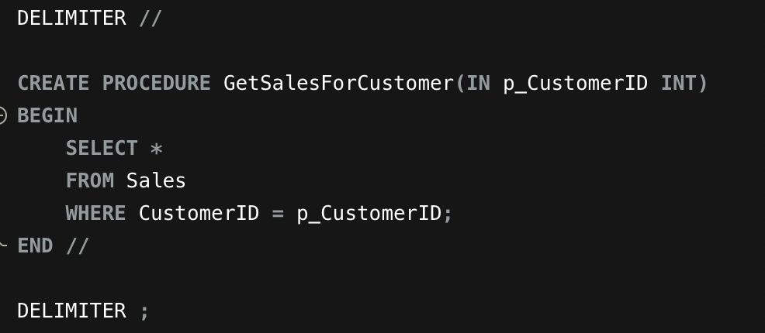
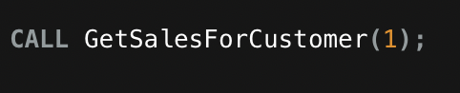
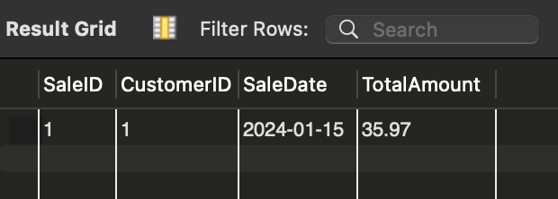
Stored procedure
This procedure retrieves sales information for a given customer ID.

Slide 9
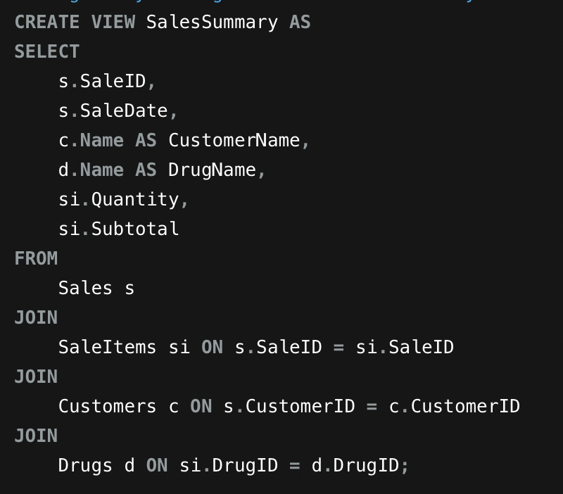
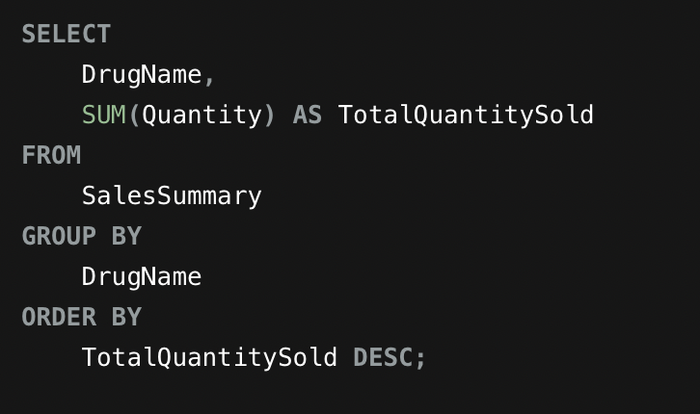
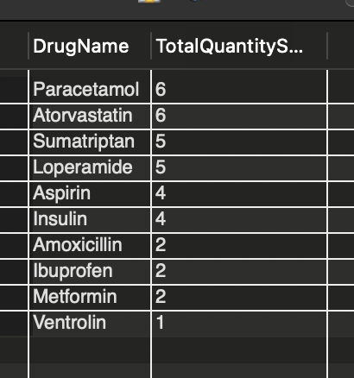
View that uses at least 3-4 base tables
View called Sales Summary that calculates the top-selling drugs by total quantity sold

Slide 10
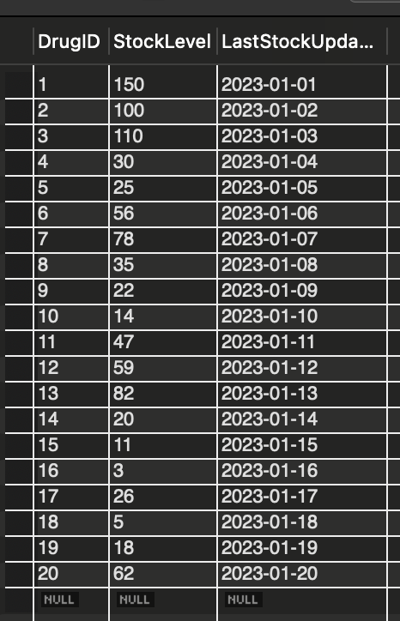
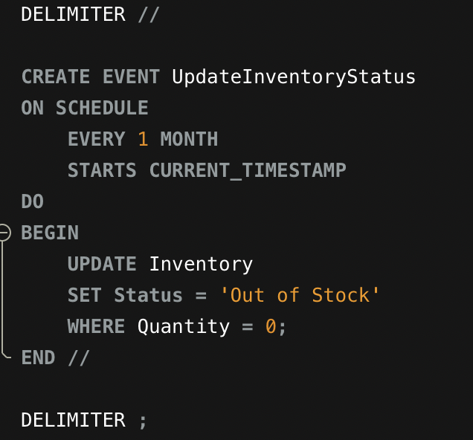

Event

